Slide 1




Sport Analysis for 4 Big Leagues
Zihan Gao, Brain McCullough, Steve Sopko, Wesley Dinville

Slide 2

Introduction
Professional sports are a big business in America. The four biggest team sports are MLB, the NFL, the NBA, and the NHL. These leagues combined have revenues totaling over $30 billion. The source of all this revenue is, of course, the fans of the teams in each of these sports leagues. Fans go to games or watch from home or elsewhere to watch their favorite teams, and they want to see them win. They want them to win games, and they want them to win championships. If a team is doing poorly, the fans start to become disinterested in the games. That hurts the team's revenue and the league's as a whole.To keep the fans interested, these four leagues have enacted different policies intended to level the playing field so that bad teams can improve, giving their fans a reason to keep going to games. Such policies include awarding top draft picks to the teams with the worst records, revenue sharing, salary caps for teams, luxury taxes for teams that exceed the caps, and even revenue sharing so that a few teams dominate the sport, driving away fans of the other teams who see no hope for victory.We are looking at how each league is managing to keep the sport competitive, so that the race to the playoffs is exciting and at times unpredictable. We examined the disparity in each of these sports between the teams finishing the seasons with the best five records every year to see how big is the gap between the best records and the worst records. We then compared our findings for each sport to see how competitive each sport is compared to each other, and see which sport has the biggest disparity between its best and worst teams for any given year. We determined this by visualizations of the winning percentages for each sport for the seasons from 2000 to 2017, and with a statistical analysis of our data.

Slide 3

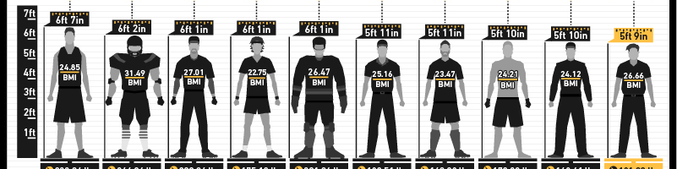
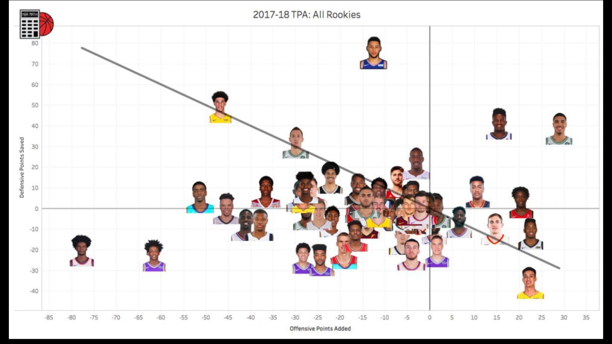

NBA Part
Interesting NBA facts that you might not know

Slide 4



Observation:
Is the NBA doing enough to keep the League Competitive?
Is the NBA losing popularity because less competitive?
QUITTING!! Giving up the current season because bad records.
“This award-contingent possibility, also called a “super-max contract,” is partly intended to help small-market teams hold onto stars who might otherwise leave for more tantalizing destinations like Los Angeles, New York, and Miami.”
What is the gap between the top teams and weak teams in a sport leagues?

Slide 5
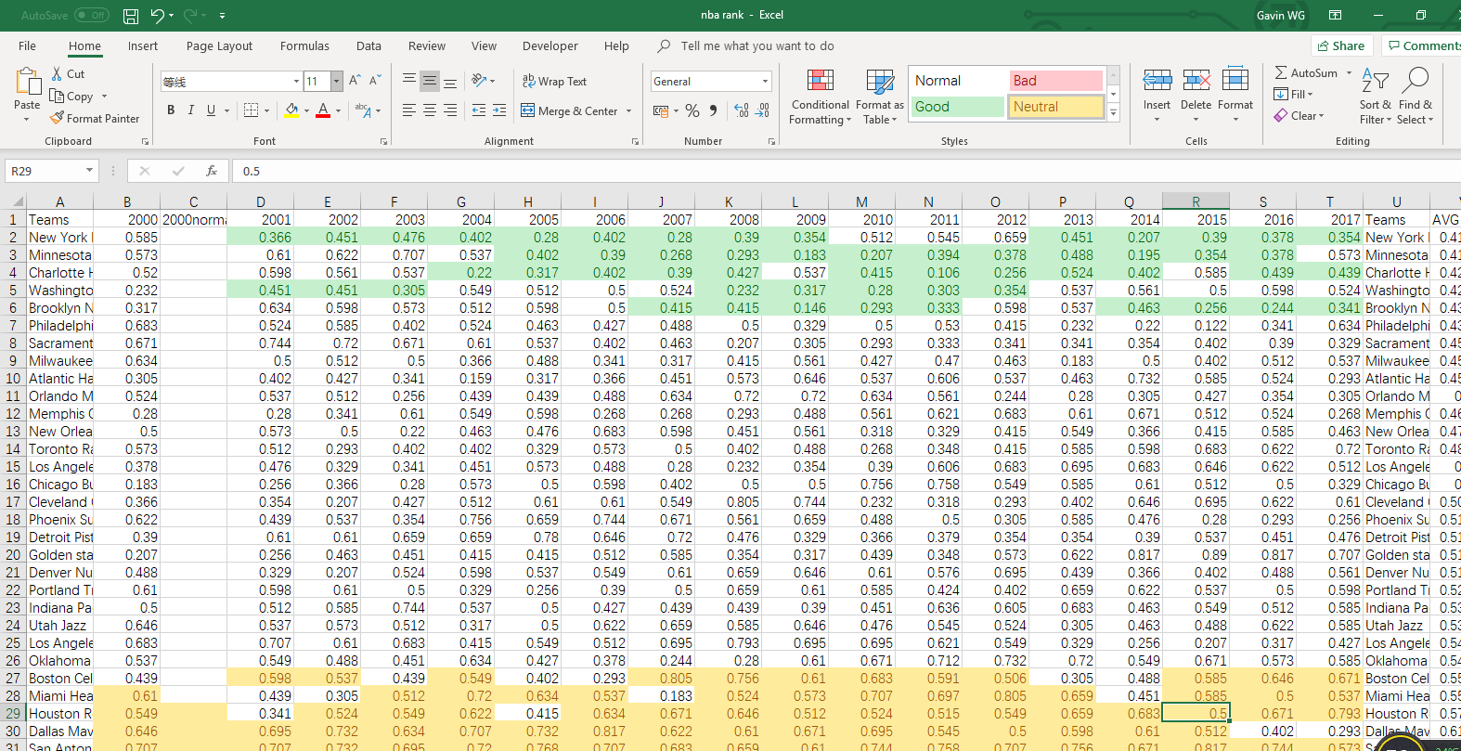
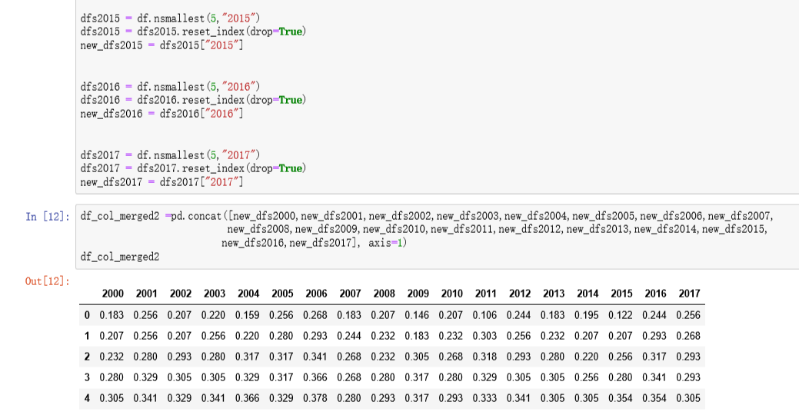
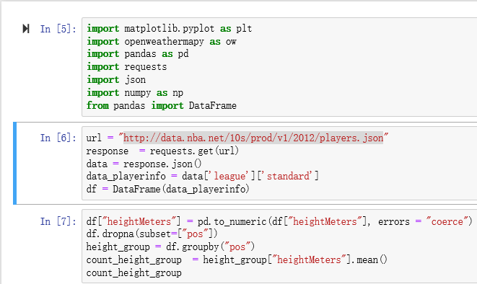
Tools I used:
Step 1: Getting Data
Step 2: Making Data Frame
1.Excel 2.Pandas
Step 3: Visualize the Data
Step 4: Analyzing Data

Slide 6
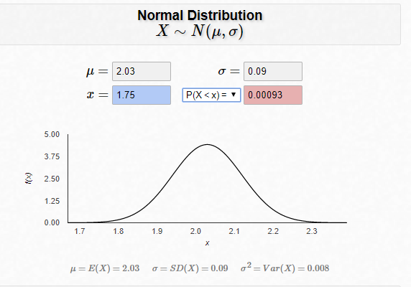
HEIGHT M
Year | 2012-2013 | 2012-2013 | 2013-2014 | 2014-2015 | 2015-2016 | 2016-2017 | 2017-2018 | 2018-2019 | AVG height
C | 2.124 | 2.124 | 2.1233 | 2.1008 | 2.126852 | 2.127869 | 2.121452 | 2.122182 | 2.120922
PF/C | 2.075 | 2.075 | 2.082 | 2.083333 | 2.097407 | 2.09875 | 2.092174 | 2.089 | 2.088238
SF | 2.0388 | 2.0388 | 2.059615 | 2.048333 | 2.047365 | 2.051933 | 2.044855 | 2.049337 | 2.048605
SG/SF | 1.9767 | 1.9767 | 1.982857 | 1.993333 | 1.999697 | 1.994054 | 1.992857 | 1.99697 | 1.990924
G | 1.90043 | 1.90043 | 1.909259 | 1.914444 | 1.915974 | 1.916358 | 1.919077 | 1.926283 | 1.914546
WEIGHT KG
Year | 2012-2013 |  | 2013-2014 | 2014-2015 | 2015-2016 | 2016-2017 | 2017-2018 | 2018-2019 | AVG weight
C | 117.07 |  | 117.633333 | 117.216667 | 117.0519 | 115.382 | 114.4355 | 114.3636 | 116.1647
PF/C | 111.55 |  | 112.25 | 113.4 | 111.6682 | 112.4083 | 111.4348 | 112.18 | 112.1273
SF | 104.276 |  | 105.257692 | 103.041667 | 104.2912 | 104.1367 | 102.9138 | 103.0307 | 103.8497
SG/SF | 99.066667 |  | 97.014286 | 97.2 | 98.29697 | 99.61429 | 97.36522 | 96.20909 | 97.82379
G | 88.746429 |  | 89.276 | 88.625926 | 88.43896 | 88.8358 | 88.59282 | 89.6623 | 88.88261
Mean height of NBA player for last 7 seasons = 2.03 meter/6.67 feet
Mean Std = 0.09 meter
Mean weight of NBA player for last 7 seasons = 109 KG

Slide 7






Some goals you may want to chase…
Steve Adams
height: 7 feet
Weight:116 KG
Lebron James
height: 6.8 feet
Weight:112 KG
Klay Thompson
height: 6.7 feet
Weight: 99 KG
James Harden
height: 6.5 feet
Weight: 99.8 KG
Russell Westbrook
height: 6.3 feet
Weight: 92 KG

Slide 8

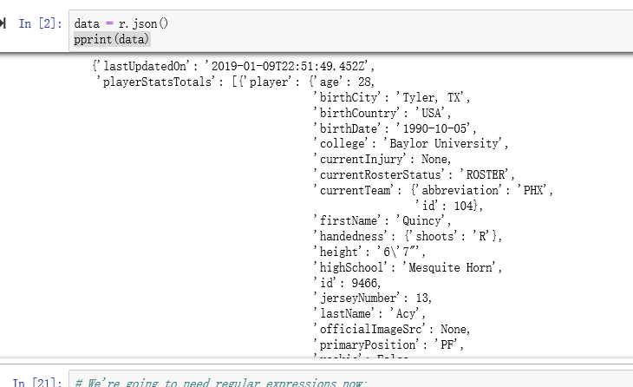
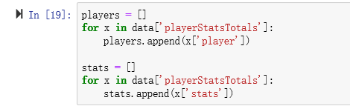
Where is the data from?
Some backstage details I want to share...
URL:
Data.nba:
http://data.nba.net/10s/prod/v1/2012/players.json
MySportfeeds
“https://api.mysportsfeeds.com/v2.0/pull/nba/{Season}/player_stats_totals.json”
Sportreference.com

Slide 9
5 Worst NBA franchise in 21st century
New York
Knicks
Minnesota
Timberwolves
Charlotte Hornets
Washington Wizards
Brooklyn
Nets
Winning rate: 41.56%
Winning rate: 41.95%
Winning rate: 42.63%
Winning rate: 42.94%
Winning rate: 43.18%
NYC Knicks has a winning rate less than 50% in 14 seasons.
Minnesota Timberwolves has a winning rate less than 50% in 12 seasons.
Charlotte Hornets has a winning rate less than 50% in 12 seasons.
Washington Wizards has a winning rate less than 50% in 8 seasons.
Brooklyn Nets has a winning rate less than 50% in 9 seasons.

Slide 10



5 Best NBA franchise in 21st century
San Antonia
Spurs
Dallas Mavericks
Houston
Rockets
Miami
Heat
Boston
Celtics
Winning rate: 70.87%
Winning rate: 61.22%
Winning rate: 57.53%
Winning rate: 55.43%
Winning rate: 55.01%
San Antonia Spurs has a winning rate greater than 50% in 17 seasons.
Dallas Mavericks has a winning rate greater than 50% in 15 seasons.
Houston Rockets has a winning rate greater than 50% in 15 seasons.
Miami Heat has a winning rate greater than 50% in 12 seasons.
Boston Celtics has a winning rate greater than 50% in 12 seasons.

Slide 11
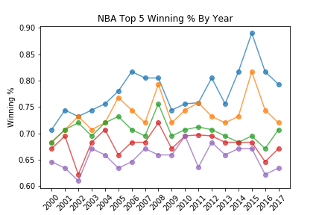
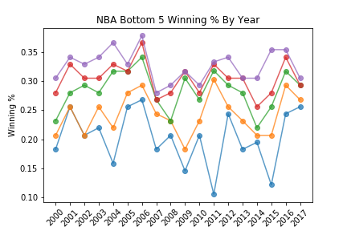
From 2000-2001 season to 2017-2018 The trend of Top 5 NBA team winning rate by year & The trend of Bottom 5NBA team winning rate by year
Avg winning rate for Top 5: 0.7109
Avg winning rate for Bottom 5: 0.27202
Avg mean from 2000-2017: 0.50000
Avg standard deviation from 2000-2017: 0.1523665345903891
Variance : 0.023

Slide 12
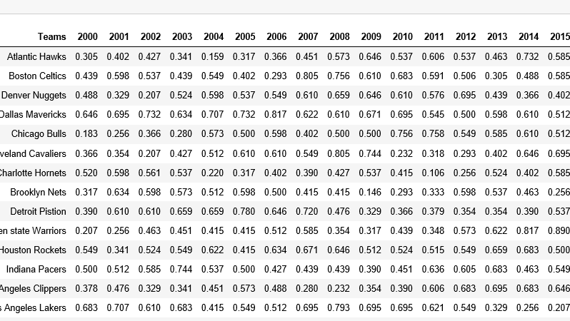
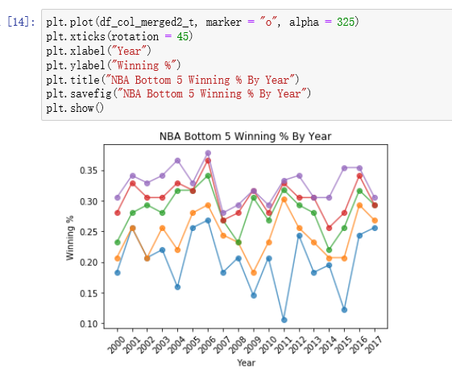
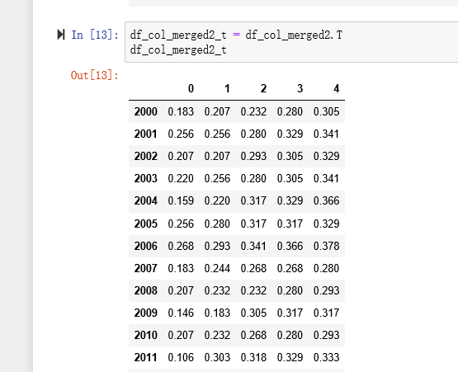
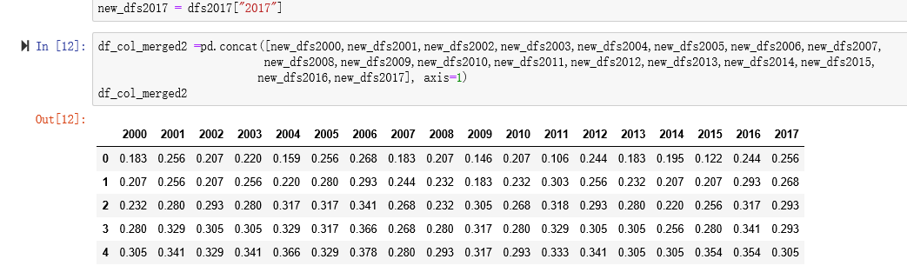
Some backstage details I want to share...again

Slide 13

Teams | AVG win% | Normal D | Rank
New York Knicks | 0.415667 | 2.5978 | 30
Minnesota Timberwolves | 0.419556 | 2.813349 | 29
Charlotte Hornets | 0.426389 | 3.206963 | 28
Washington Wizards | 0.429444 | 3.387595 | 27
Brooklyn Nets | 0.431833 | 3.530158 | 26
Philadelphia 76ers | 0.439944 | 4.017714 | 25
Sacramento Kings | 0.450722 | 4.651978 | 24
Milwaukee Bucks | 0.451556 | 4.699342 | 23
Atlantic Hawks | 0.459111 | 5.110934 | 22
Orlando Magic | 0.4655 | 5.426507 | 21
Memphis Grizzlies | 0.468056 | 5.542345 | 20
New Orleans Pelicans | 0.470278 | 5.637631 | 19
Toronto Rapters | 0.484056 | 6.096589 | 18
Los Angeles Clippers | 0.4855 | 6.130029 | 17
Chicago Bulls | 0.4865 | 6.151417 | 16
Cleveland Cavaliers | 0.500111 | 6.292455 | 15
Phoenix Suns | 0.510278 | 6.210324 | 14
Detroit Piston | 0.510333 | 6.209439 | 13
Golden state Warriors | 0.510444 | 6.207656 | 12
Denver Nuggets | 0.515778 | 6.100599 | 11
Portland Trail Blazers | 0.521611 | 5.937315 | 10
Indiana Pacers | 0.530944 | 5.585872 | 9
Utah Jazz | 0.533611 | 5.467529 | 8
Los Angeles Lakers | 0.541278 | 5.09066 | 7
Oklahoma City Thunders | 0.545056 | 4.888264 | 6
Boston Celtics | 0.550167 | 4.601107 | 5
Miami Heat | 0.554333 | 4.358529 | 4
Houston Rockets | 0.575389 | 3.103016 | 3
Dallas Mavericks | 0.612278 | 1.311581 | 2
San Antonio Spurs | 0.708778 | 0.027802 | 1
1. The average winning rate is always 50%
2. The Standard deviation of the winning rate for past 17 seasons is 0.0634
3. The probability of getting spurs record is 0.027%

Slide 14
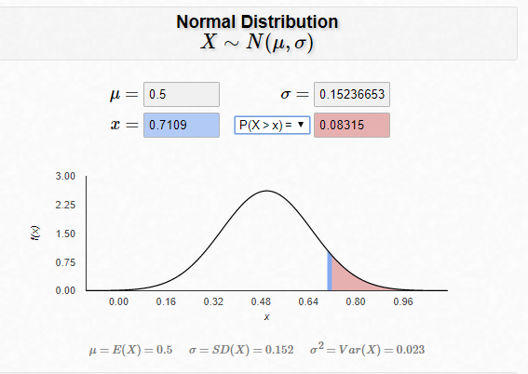
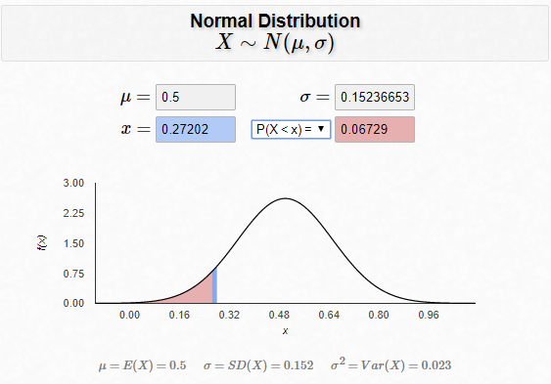
Theorem we applied :
Normal Distribution
Central limit theorem
68–95–99.7 theorem
Conclusions we can make so far:
The average winning rate is always 50%
From past 17 NBA regular seasons the gap between average Top 5 teams winning rate and Bottom 5 teams is 2.88 units of STD

Slide 15
NFL Part

Slide 16
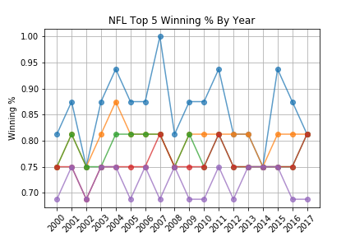
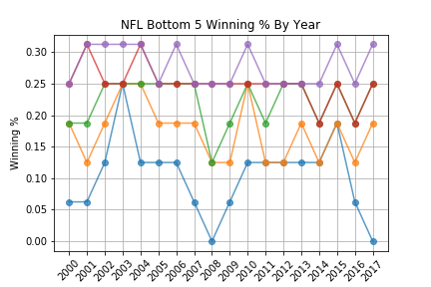
From 2000-2001 season to 2017-2018 The trend of Top 5 NFL team winning rate by year & The trend of Bottom 5 NFL team winning rate by year
Avg winning rate for Top 5: 0.78333
Avg winning rate for Bottom 5: 0.2055
Avg mean from 2000-2017: 0.50000
Avg standard deviation from 2000-2017:
0.1742852220798301
Variance : 0.03

Slide 17
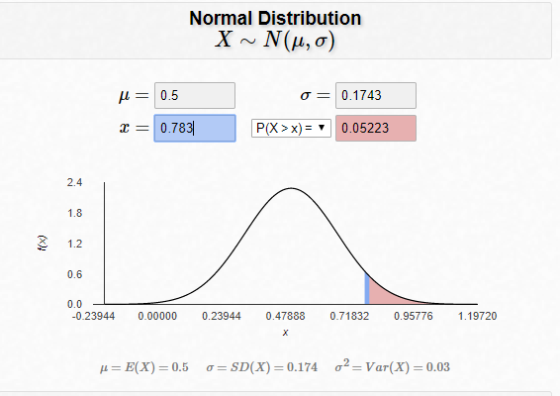
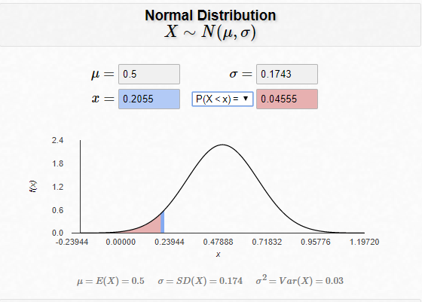
Theorem we applied :
Normal Distribution
Central limit theorem
68–95–99.7 theorem
Conclusions we can make so far:
The average winning rate is always 50%
From past 17 NFL regular seasons the gap between average Top 5 teams winning rate and Bottom 5 teams is 3.34 units of STD

Slide 18
MLB Part

Slide 19
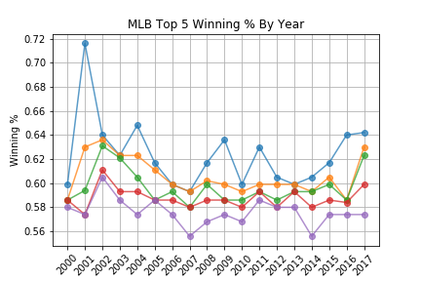
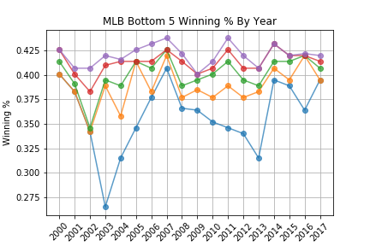
From 2000-2001 season to 2017-2018 The trend of Top 5 MLB team winning rate by year & The trend of Bottom 5 MLB team winning rate by year
Avg winning rate for Top 5: 0.5980
Avg winning rate for Bottom 5: 0.37408
Avg mean from 20002017 : 0.50000
Avg standard deviation from 2000-2017:
0.070138
Variance : 0.023

Slide 20
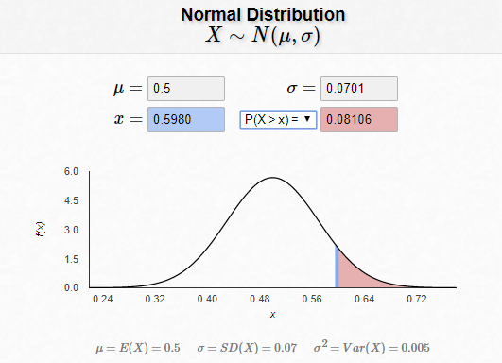
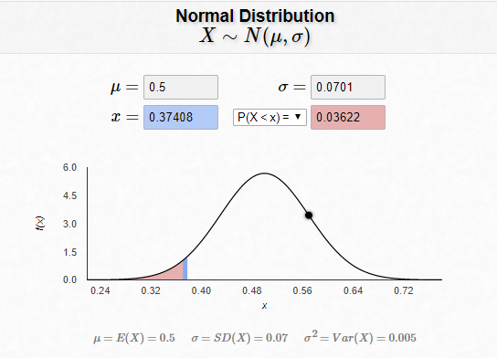
Theorem we applied :
Normal Distribution
Central limit theorem
68–95–99.7 theorem
Conclusions we can make so far:
The average winning rate is always 50%
From past 17 MLB regular seasons the gap between average Top 5 teams winning rate and Bottom 5 teams is 3.19 units of STD

Slide 21
NHL Part

Slide 22
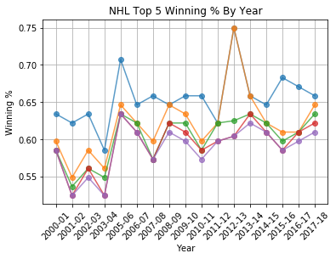
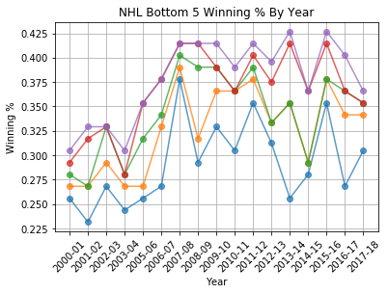
From 2000-2001 season to 2017-2018 The trend of Top 5 NHL team winning rate by year & The trend of Bottom 5 NHL team winning rate by year
Avg winning rate for Top 5: 0.6108
Avg winning rate for Bottom 5: 0.3413
Avg mean from 20002017 : 0.50000
Avg standard deviation from 2000-2017:
0.28773
Variance : 0.5653

Slide 23
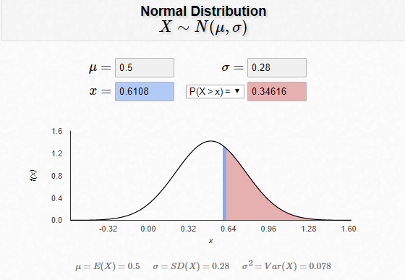
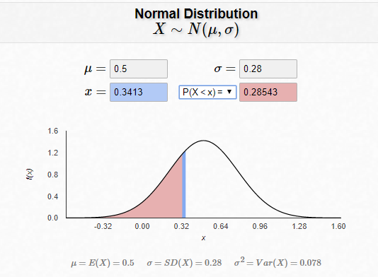
Theorem we applied :
Normal Distribution
Central limit theorem
68–95–99.7 theorem
Conclusions we can make so far:
The average winning rate is always 50%
From past 17 NHL regular seasons the gap between average Top 5 teams winning rate and Bottom 5 teams is 0.97 units of STD

Slide 24
Conclusion

